Slide 1
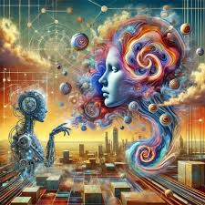
News to Emotion-based Abstract Art Generator
An AI Project using NLP and Generative Art
KL Rita Kho
NDU202400095
3rd Semester
MTech-AI
Under the Guidance of
Dr. Usham Sanjota Chanu
Assistant Professor
NIELIT IMPHAL

Slide 2


CONTENTS
Introduction
Objectives
Architecture
Methodology
Snapshot
Technology
Result
Social Impact
Conclusion
References

Slide 3
INTRODUCTION
News media reflects not only information but also societal emotions such as fear, anger, hope, and joy, which influence public perception and decisions.
Although AI can detect emotions from news text, results are usually shown as numbers or labels that are difficult for humans to interpret.
News often contains mixed and complex emotions that traditional sentiment analysis cannot represent effectively.
This project uses AI to transform emotions from news text into abstract visual art, making emotional trends more intuitive and human-friendly.

Slide 4
OBJECTIVES
To collect real-time news text from online platforms and analyze its emotional content.
To accurately detect fine-grained and mixed emotions in news using emotion-aware NLP models.
To convert detected emotions into meaningful artistic parameters such as color, texture, and balance.
To generate emotion-driven abstract visual art using generative AI techniques.
To provide an intuitive and human-centered way of understanding emotional trends present in news media.

Slide 5
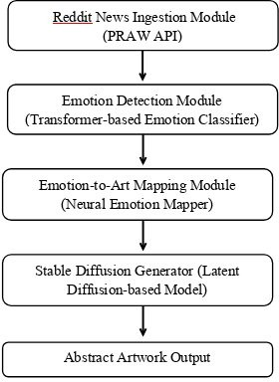
ARCHITECTURE
News Input
Headlines and summaries
Preprocessing
Text cleaning and tokenization
Emotion Detection
NLP classification
Visual Mapping
Emotion to parameters
Generation
AI-based synthesis
Artistic Output
Emotion-aware art

Slide 6
METHODOLOGY
Data Collection: Curated public news datasets containing diverse headlines and summaries from multiple sources and categories.
Emotion Detection: Transformer-based NLP models perform multi-label emotion classification to identify complex emotional patterns.
Visual Mapping: Emotions are systematically mapped to color hue, brush texture, symmetry levels, and randomness parameters.
Image Generation: Text-to-image synthesis powered by Stable Diffusion creates emotionally aligned artistic outputs.

Slide 7
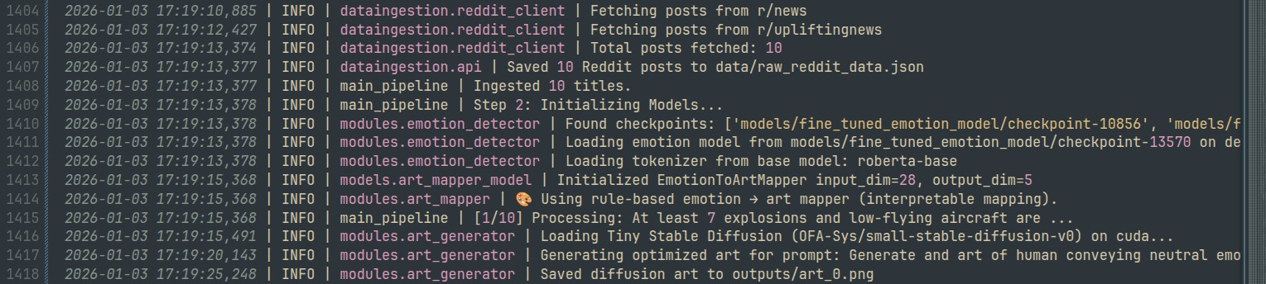
Snapshots
This is the pipeline for getting the data and generating the art
Fetches Reddit posts
Analyzes emotions from text
Maps emotions to artistic styles
Generates AI art using Stable Diffusion
Generates artwork

Slide 8
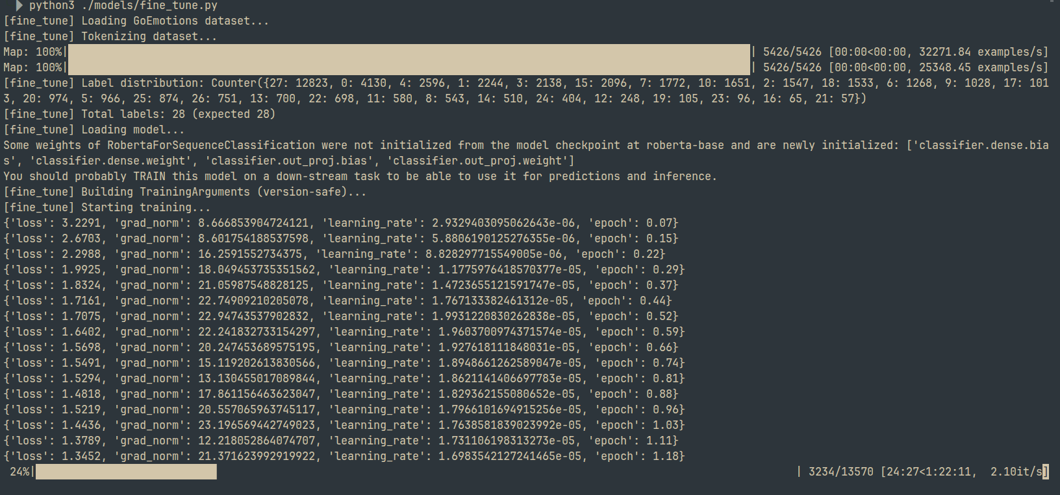
Snapshots
This is the Model Training Phase

Slide 9
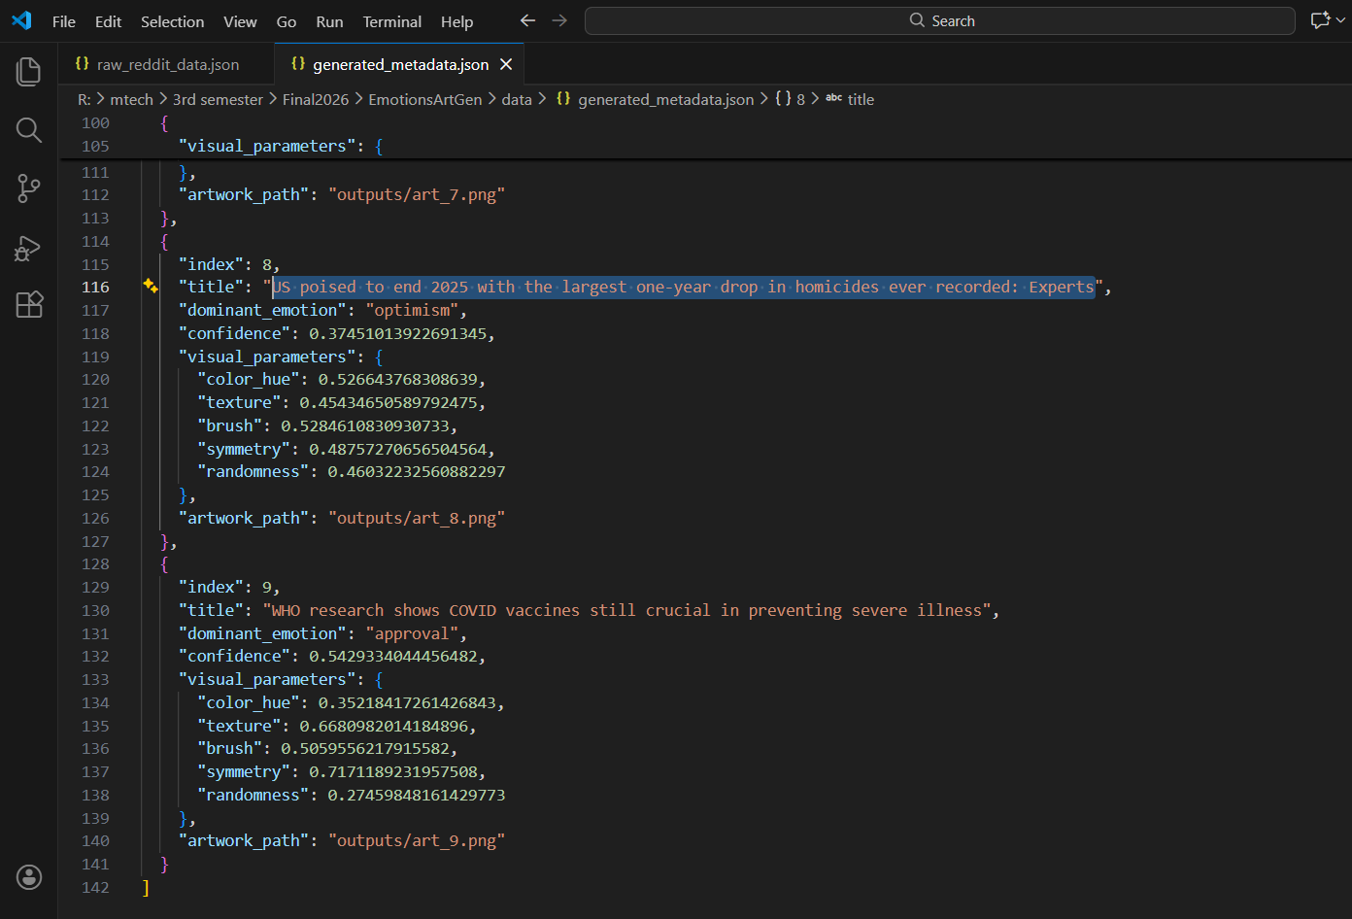
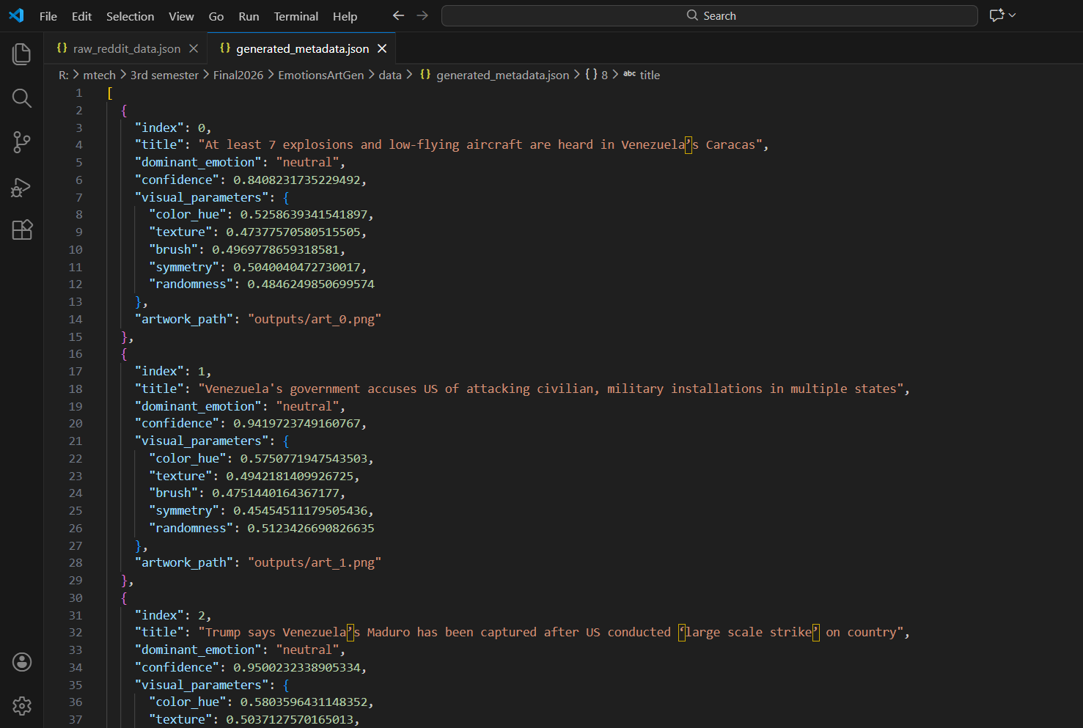
Snapshots
This is the art outcome

Slide 10
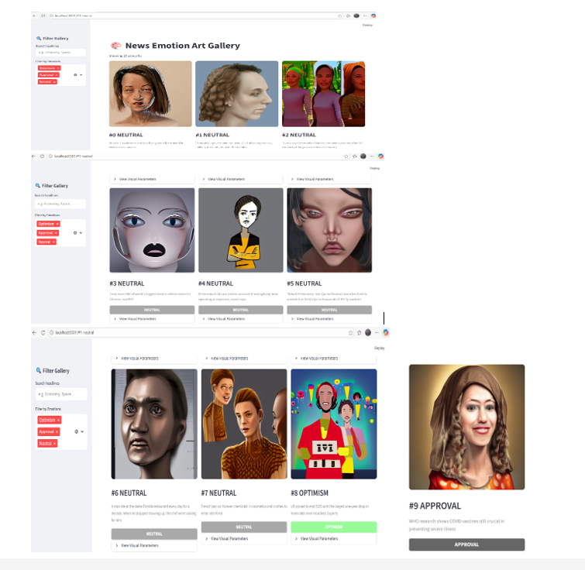
Snapshots

Slide 11
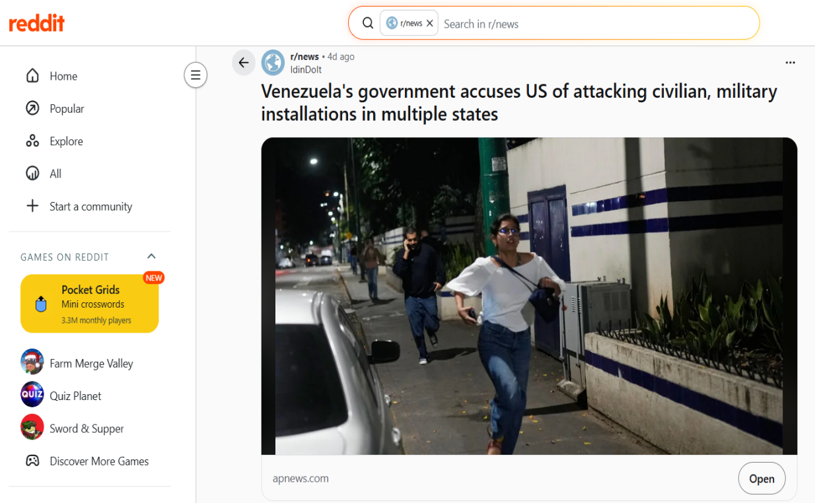
Snapshots
Venezuela's government accuses US of attacking civilian, military installations in multiple states
https://www.reddit.com/r/UpliftingNews/comments/1q2f0t7/us_poised_to_end_2025_with_the_largest_oneyear/

Slide 12
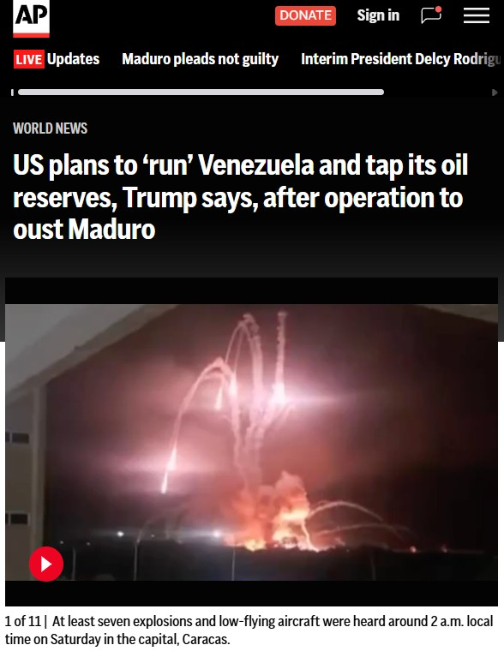
Snapshots
https://apnews.com/article/venezuela-us-explosions-caracas ca712a67aaefc30b1831f5bf0b50665e?utm_source=copy&utm_medium=share

Slide 13
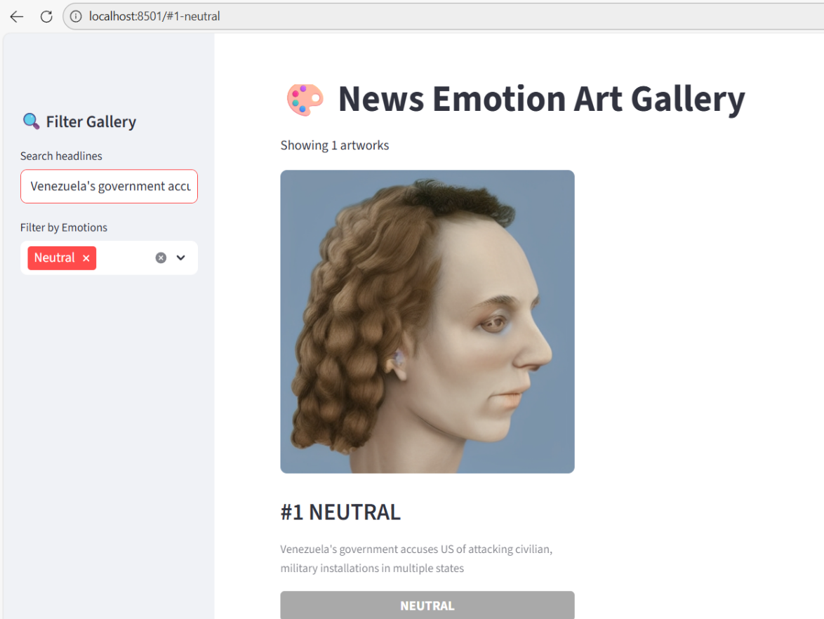
Snapshots
Generated Art

Slide 14
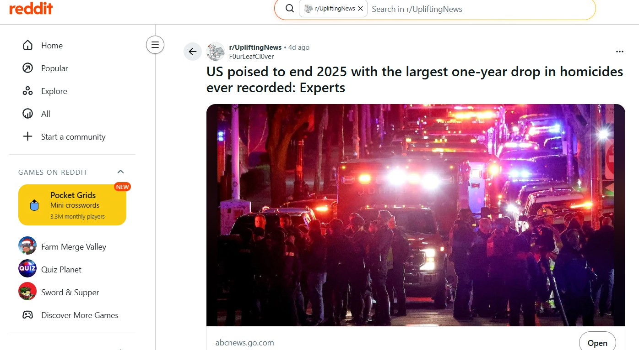
Snapshots
US poised to end 2025 with the largest one-year drop in homicides ever recorded: Experts
https://www.reddit.com/r/UpliftingNews/comments/1q2f0t7/us_poised_to_end_2025_with_the_largest_oneyear/

Slide 15
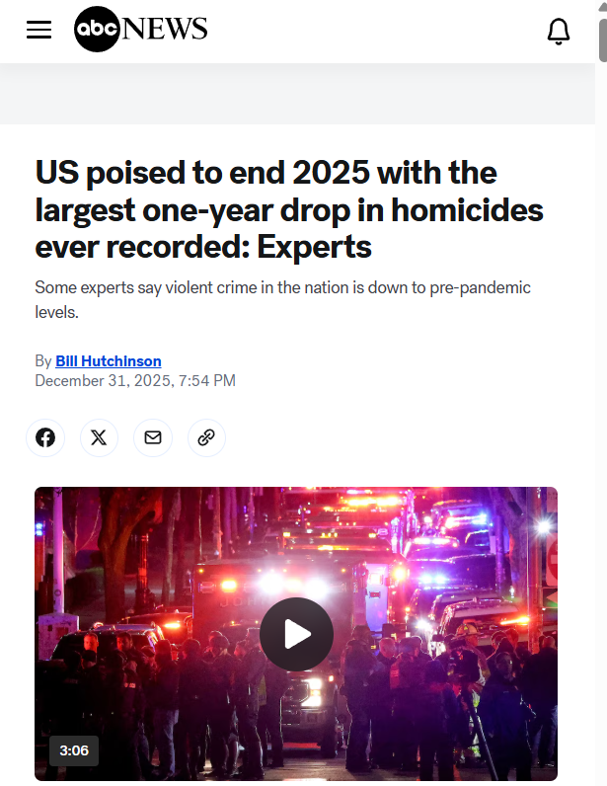
Snapshots
https://abcnews.go.com/US/us-poised-end-2025-largest-year-drop-homicides/story?id=128646976

Slide 16
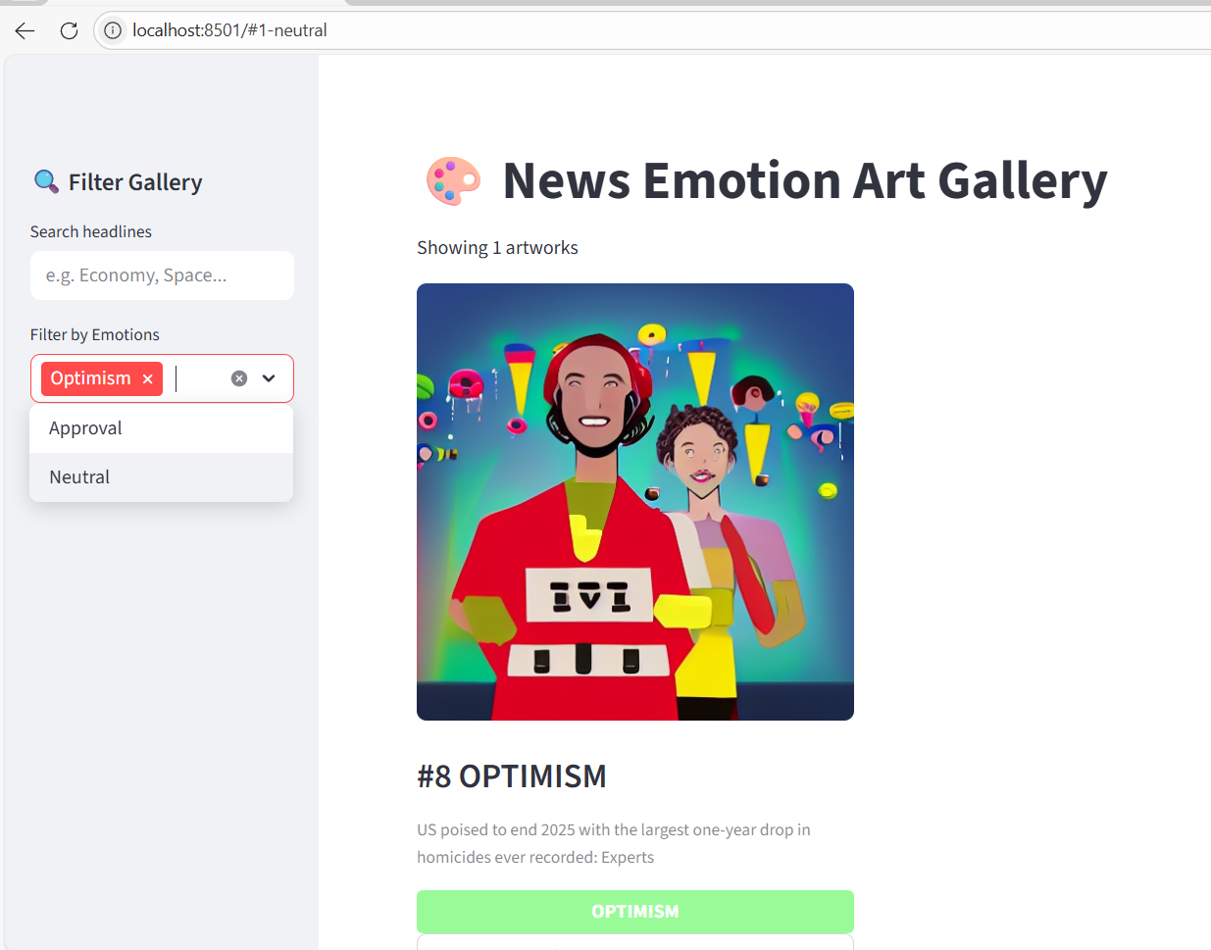
Snapshots
Generated Art

Slide 17
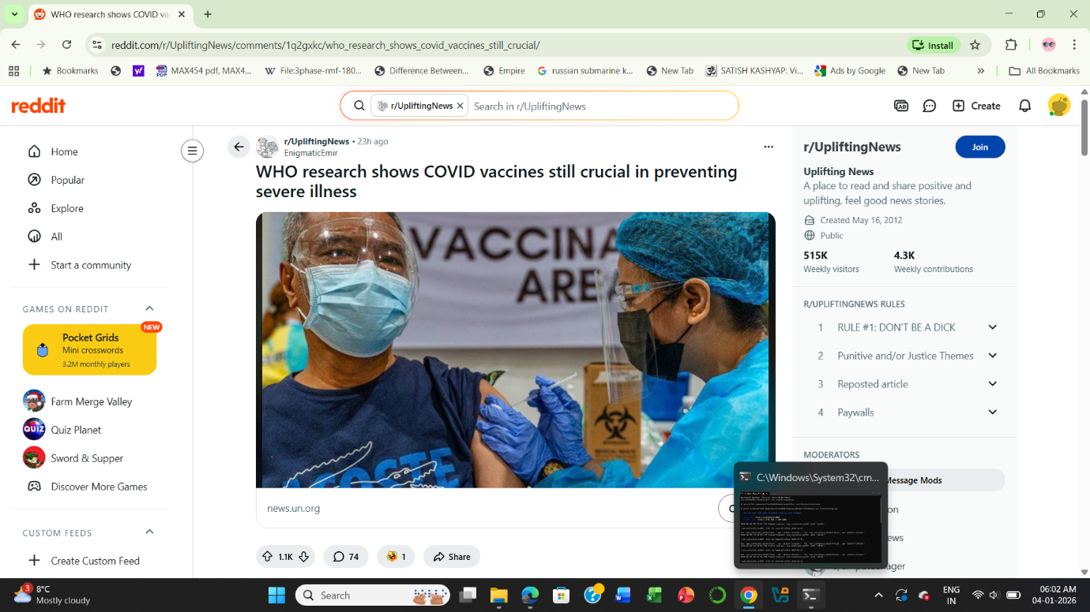
Snapshots
WHO research shows COVID vaccines still crucial in preventing severe illness
https://www.reddit.com/r/UpliftingNews/comments/1q2gxkc/who_research_shows_covid_vaccines_still_crucial/

Slide 18
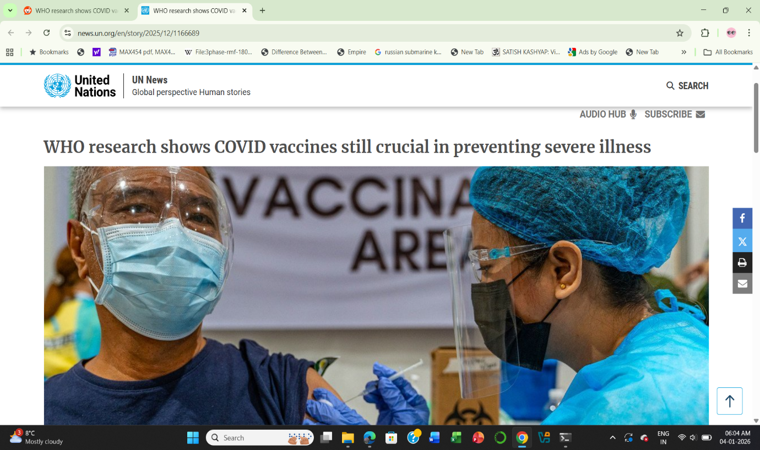
Snapshots
https://news.un.org/en/story/2025/12/1166689

Slide 19
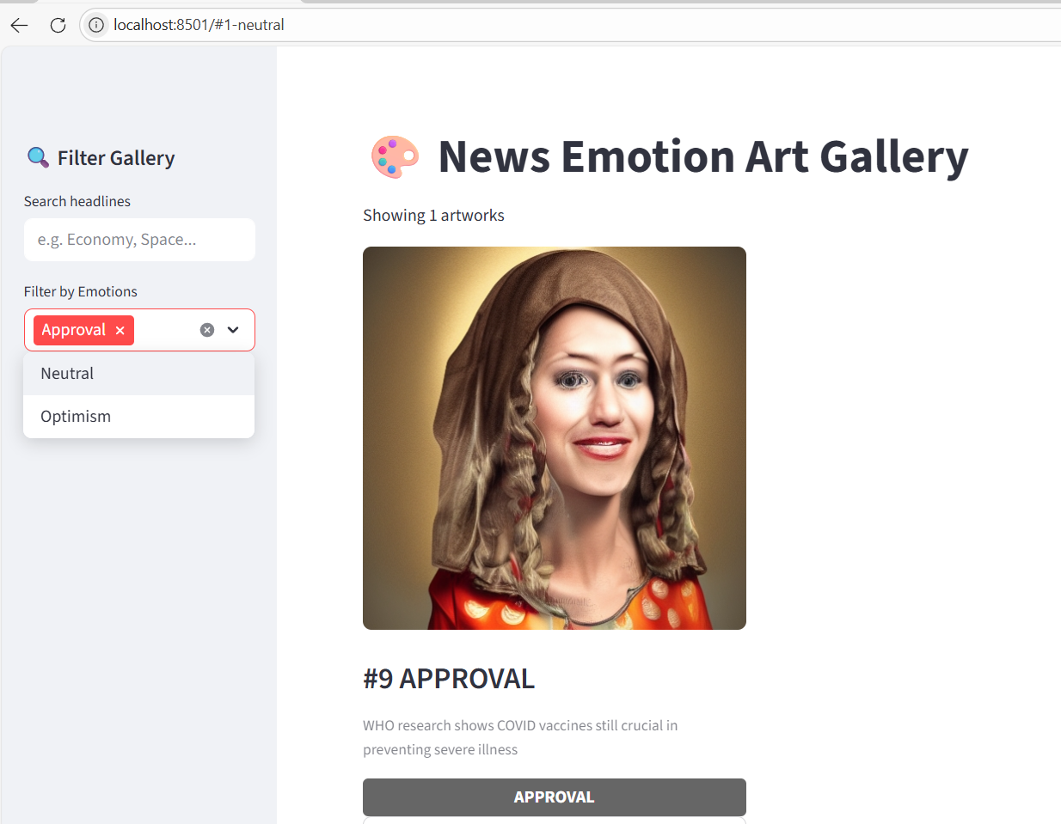
Snapshots
Generated Art

Slide 20
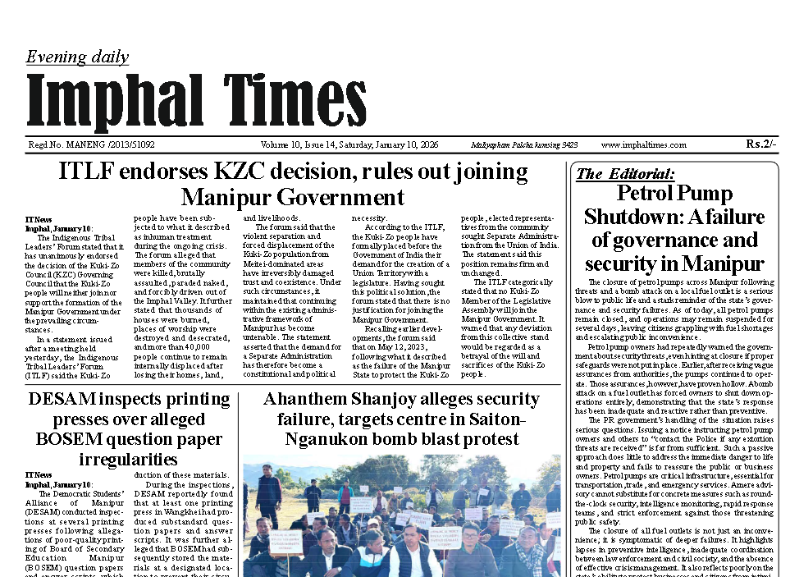
Snapshots
Screenshot of the Input and Output (Local Newspaper)
Ahanthem Shanjoy alleges security failure, targets centre in Saiton-Nganukon bomb blast protest

Slide 21

Snapshots
Generated Art
Generated Art (Local Newspaper)

Slide 22
TECHNOLOGY STACK
Tools & Technologies
Python Ecosystem: Core programming language with NumPy, Pandas, and Matplotlib for data processing and visualization.
NLP Framework: Transformer models from Hugging Face for state-of-the-art natural language understanding and emotion detection.
Deep Learning: PyTorch framework providing flexible neural network architecture and GPU acceleration capabilities.
Generative AI: Stable Diffusion model for high-quality text- to-image synthesis with emotion-aware prompting.
Hardware: GPU-accelerated computing system enabling efficient model training and real- time image generation.

Slide 23
RESULTS
Successful Generation
The system successfully generated emotionally aligned artistic images with clear visual-emotional correlation across diverse news content.
Visual Patterns
Positive emotions consistently produced brighter, more structured visuals while negative emotions generated darker, chaotic textures.
Performance Insights
GPU memory limitations affected batch processing speed. Emotion detection accuracy proved critical for visual quality outcomes.
The strong correlation between emotion type and visual characteristics validates the core hypothesis that emotions can be meaningfully translated into artistic representations.

Slide 24
SOCIAL IMPACT
Benefits to Society
General Public
Media & Journalism
Enables emotion-aware visual storytelling
Improves audience engagement and empathy
Enhances digital content presentation
Education & Inclusion
Valuable learning tool for NLP and Generative AI courses
Demonstrates ethical AI concepts
Helps overcome language barriers and reading difficulties
Helps people understand emotions behind news easily.
Makes public mood more visible and relatable.
Encourages deeper thinking beyond headlines.
Uses art to communicate emotions in a simple way.

Slide 25
CONCLUSION
This research successfully developed an emotion-aware news-to-art AI system that integrates NLP emotion detection with generative art models. The system demonstrates meaningful emotional visualization of news data, creating a bridge between textual information and artistic expression.
Future Scope
Real-time Integration
Connect to live news streams for immediate visualization
Global Reach
Expand to multi-lingual news processing capabilities
Interactive Platform
Develop web-based dashboard for public access

Slide 26
REFERENCES
[1] Devlin, J., Chang, M.-W., Lee, K., & Toutanova, K. (2019). BERT: Pre-training of Deep Bidirectional Transformers for Language Understanding. Proceedings of the 2019 Conference of the North American Chapter of the Association for Computational Linguistics (NAACL-HLT), pp. 4171–4186.
[2] Mohammad, S. M. (2016). Sentiment Analysis: Detecting Valence, Emotions, and Other Affectual States. In Emotion Measurement, Elsevier, pp. 201–237.
[3] Goodfellow, I., Pouget-Abadie, J., Mirza, M., Xu, B., Warde-Farley, D., Ozair, S., Courville, A., & Bengio, Y. (2014). Generative Adversarial Nets.Advances in Neural Information Processing Systems (NeurIPS), Vol. 27.
[4] Mirza, M., & Osindero, S. (2014). Conditional Generative Adversarial Nets. arXiv preprint arXiv:1411.1784.
[5] Xu, T., Zhang, P., Huang, Q., Zhang, H., Gan, Z., Huang, X., & He, X. (2018). AttnGAN: Fine-Grained Text to Image Generation. Proceedings of the IEEE
Conference on Computer Vision and Pattern Recognition (CVPR), pp. 1316–1324.
[6] Ho, J., Jain, A., & Abbeel, P. (2020). Denoising Diffusion Probabilistic Models. Advances in Neural Information Processing Systems (NeurIPS), Vol. 33, pp. 6840–6851.
[7] Rombach, R., Blattmann, A., Lorenz, D., Esser, P., & Ommer, B. (2022). High-Resolution Image Synthesis with Latent Diffusion Models. Proceedings of the IEEE/CVF Conference on Computer Vision and Pattern Recognition (CVPR), pp. 10684–10695.
[8] https://www.reddit.com/?feed=home
[9] https://huggingface.co/SamLowe/roberta-base-go_emotions
[10] https://huggingface.co/distilbert/distilroberta-base
[11] https://huggingface.co/learn/diffusion-course/en/unit0/1
[12]https://huggingface.co/docs/transformers/en/main_classes/tokenizer

Slide 27
THANK YOU

